Slide 1


BCSE307L – Compiler Design
Module 5 – Code Optimization

Slide 2
Loops in Flow Graphs

Slide 3
Dominators
In a flow graph, a node ‘d’ is said to be dominates node ‘n’ if every path to node n from initial node goes through d only.
This can be denoted as ’d dom n'.
Every initial node dominates all the remaining nodes in the flow graph.
Every node dominates itself.
Node 1 is initial node and it dominates every node as it is initial node.
Node 2 dominates 3, 4 and 5.
1
2
3
4
5

Slide 4
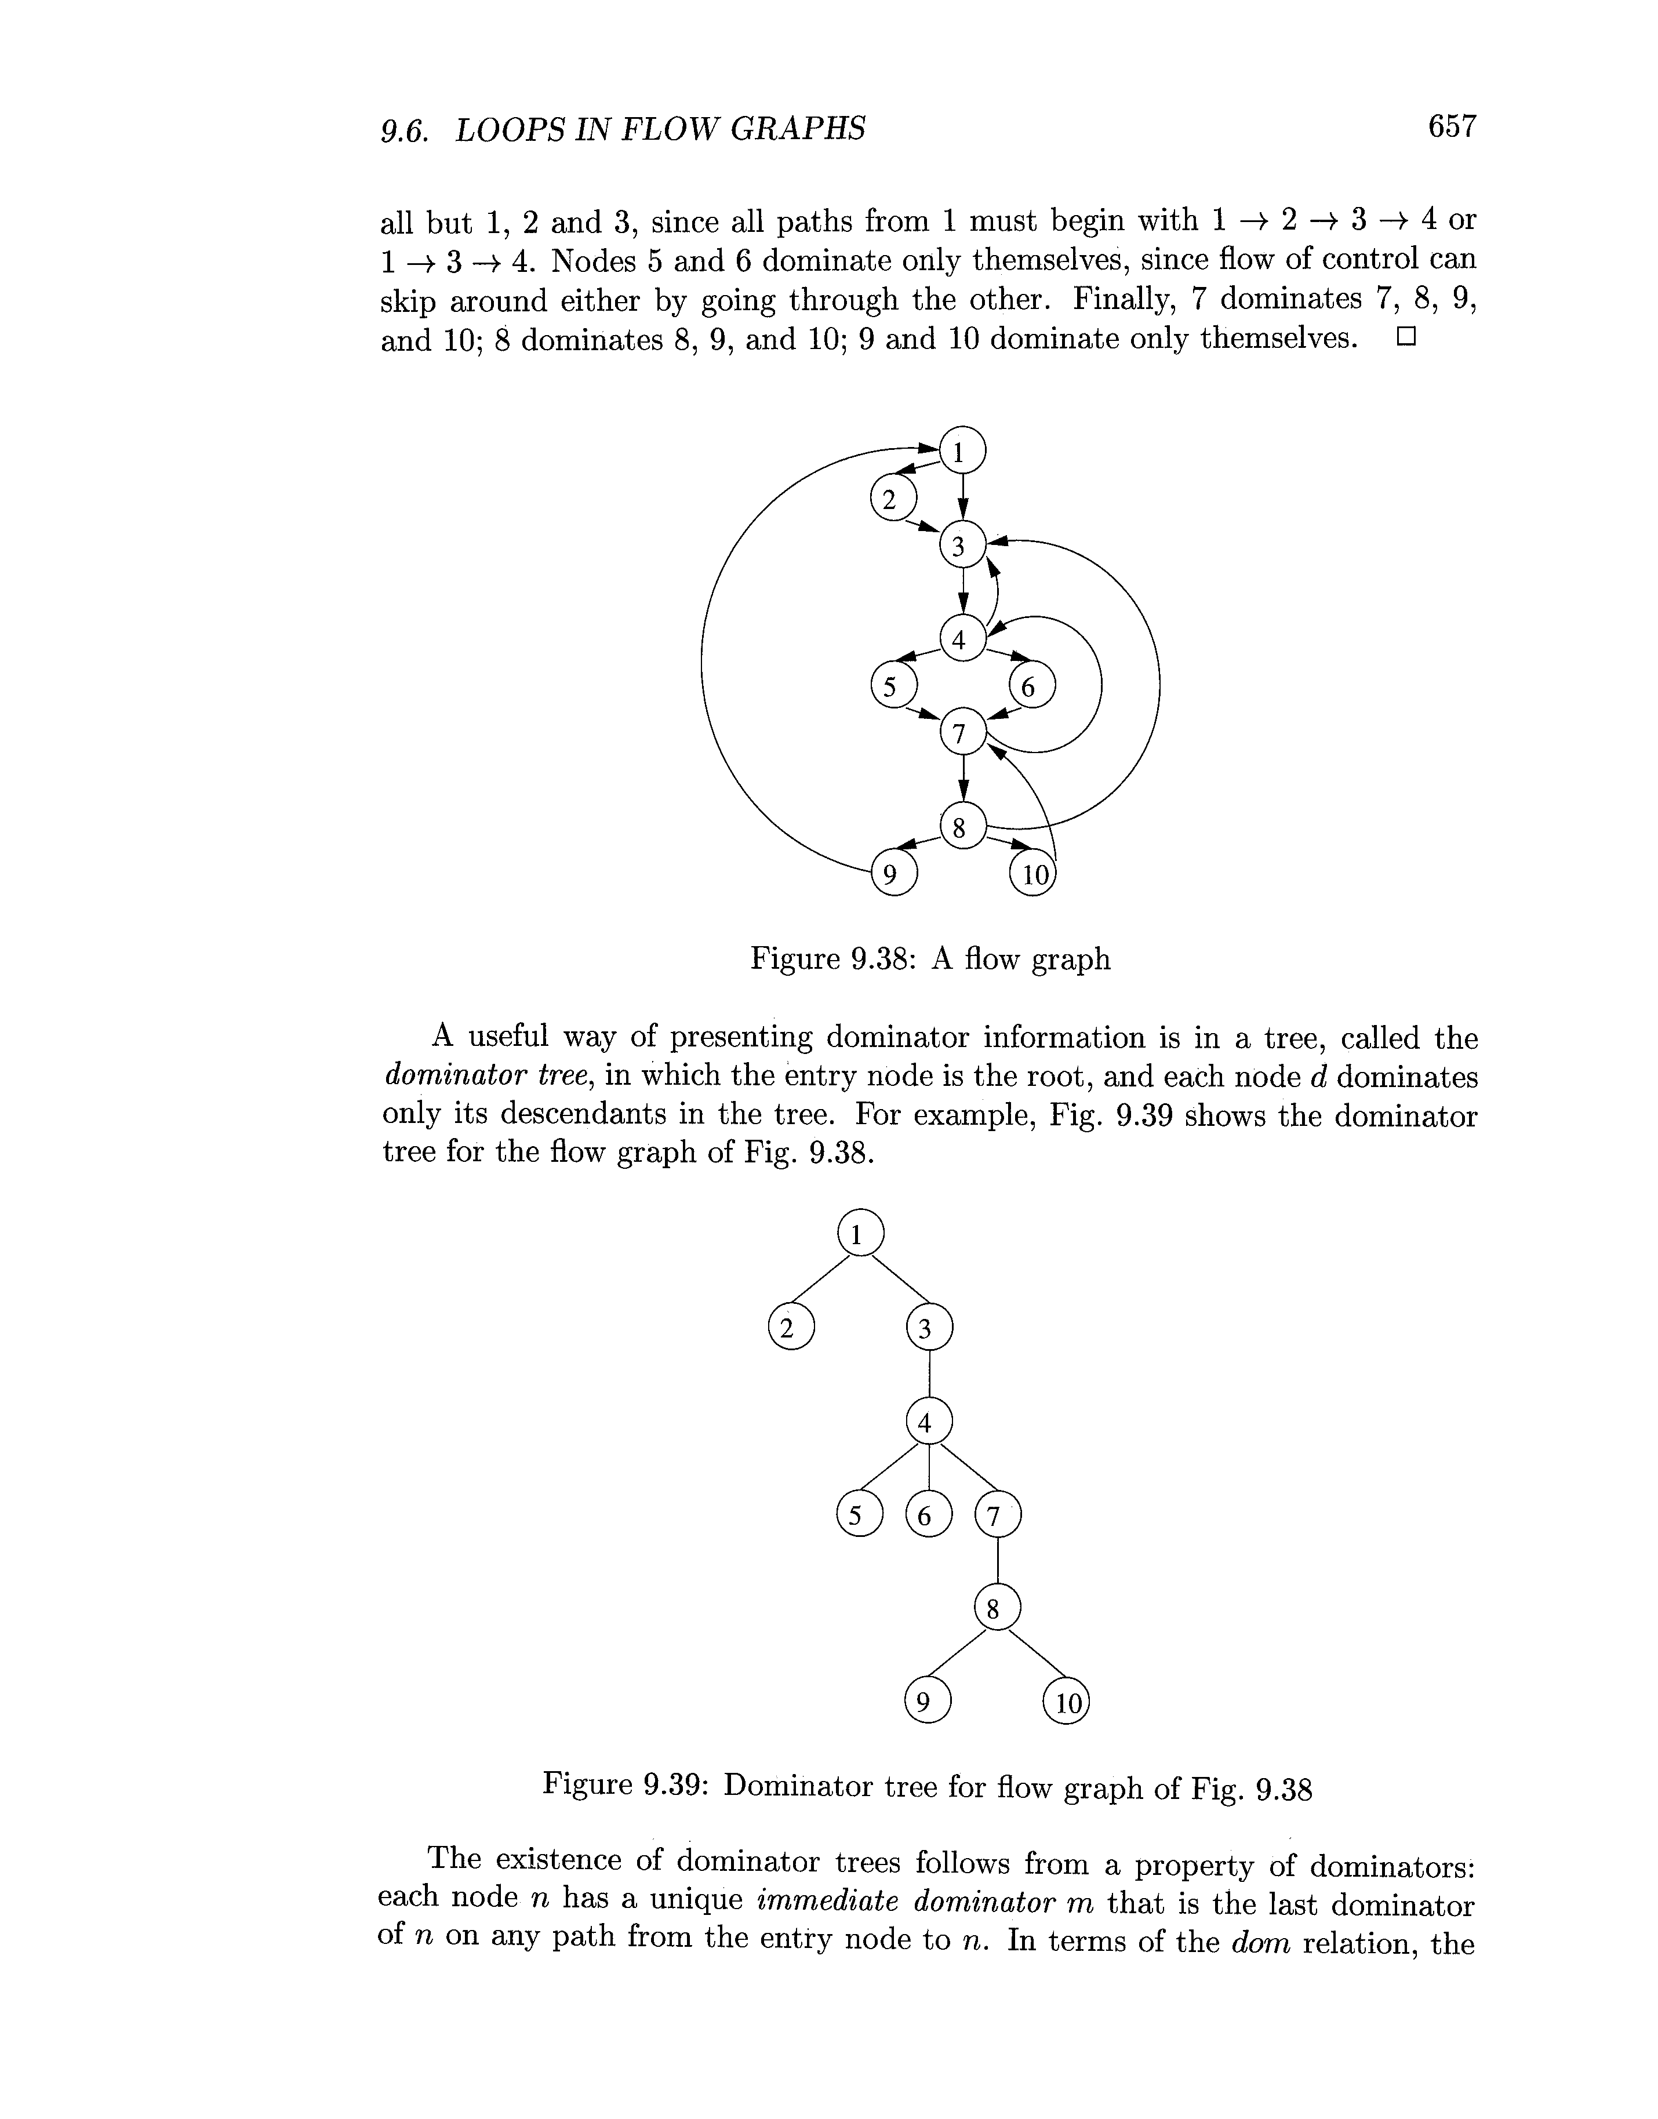
Cont.,
Dominator tree
A flow graph

Slide 5
Natural Loops
There are two essential properties of natural loop:
A loop must have single entry point, called the header. This point dominates all nodes in the loop.
There must be a back edge that enters the loop header. There must be at least one way to iterate loop.
Given a back edge n + d, we define the natural loop of the edge to be d plus the set of nodes that can reach n without going through d.
Node d is the header of the loop.
6→1 is natural loop.
Header
1
2
3
4
5
6

Slide 6
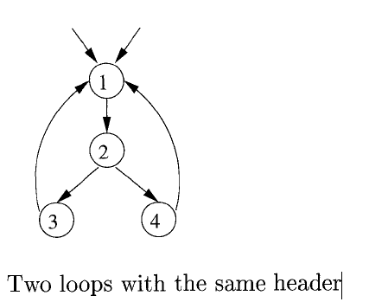
Inner Loops
The inner loop is a loop that contains no other loop.
Here the inner loop is 4→2 that mean edge given by 2-3-4.
1
2
3
4
5

Slide 7

Preheader
Several transformation require us to move statements “before the header”.
Therefore begin treatment of a loop $L$ by creating a new block, called the preheader.
The preheader has only the header as successor.
Preheader
Header
B₀

Slide 8
Reducible Flow Graph
The reducible graph is a flow graph, if and only if we can partition the edges into two disjoint groups, in which often called the forward edges and backward edges.
These edges have following properties,
The forward edge forms an acyclic graph in which every node has to be reached from the initial node.
The back edges are such edges whose head dominates their tail.
1
2
3
4
5

Slide 9
Non-reducible Flow Graph
A non reducible flow graph is a flow graph in which:
There are no back edges.
Forward edges may produce cycle in the graph.
1
2
3

Slide 10
DAG Representation of Basic Block

Slide 11
Algorithm: DAG Construction
We assume the three address statement could of following types:
Case (i) x:=y op z
Case (ii) x:=op y
Case (iii) x:=y
With the help of following steps the DAG can be constructed.
Step 1: If y is undefined then create node(y). Similarly if z is undefined create a node (z)
Step 2:
Case(i) create a node(op) whose left child is node(y) and node(z) will be the right child. Also check for any common sub expressions.
Case (ii) determine whether is a node labeled op, such node will have a child node(y).
Case (iii) node n win be node(y).
Step 3: Delete x from list of identifiers for node(x). Append x to the list of attached identifiers for node n found in 2.

Slide 12







DAG Representation of Basic Block
Example:
(1) t1 := 4*i
(2) t2 := a [t1]
(3) t3 := 4*i
(4) t4 :=b [t3]
(5) t5 := t2*t4
(6) t6 := prod +t5
(7) prod := t6
(8) t7 := i+1
(9) i := t7
(10) if i<=20 goto (1)
, prod
t₆
$$+$$
prod
$$∗$$
t₅
t₄
$$≤$$
(1)
$$[ ]$$
t₂
$$[ ]$$
,t₃
t₁
$$∗$$
$$+$$
t₇
20
, i
a
b
4
i
1

Slide 13
Applications of DAG
The DAGs are used in following:
Determining the common sub-expressions.
Determining which names are used inside the block and computed outside the block.
Determining which statements of the block could have their computed value outside the block.
Simplifying the list of quadruples by eliminating the common sub-expressions and not performing the assignment of the form x:=y unless and until it is a must.

Slide 14
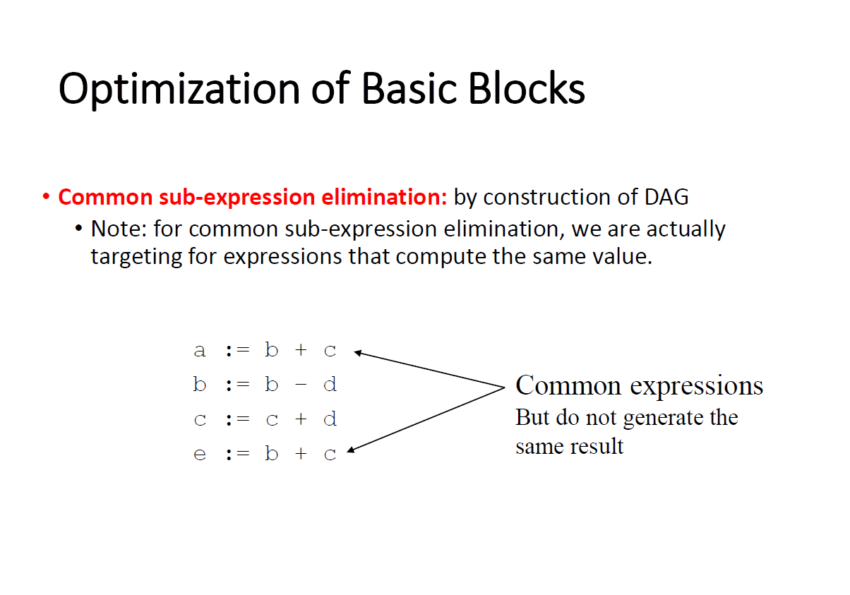

Slide 15
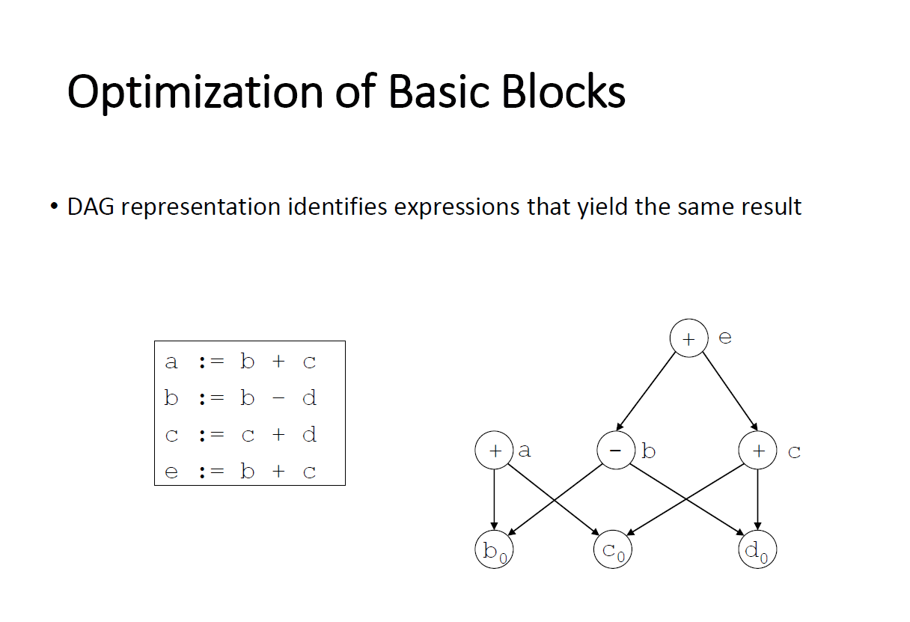

Slide 16
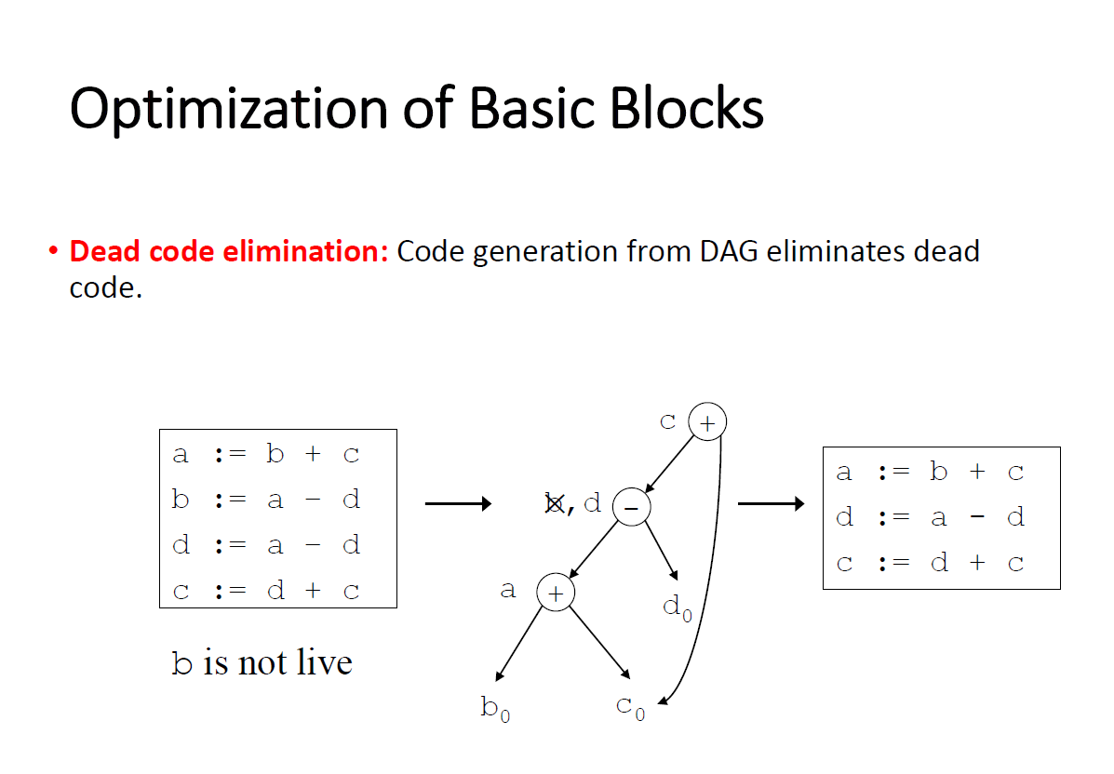

Slide 17
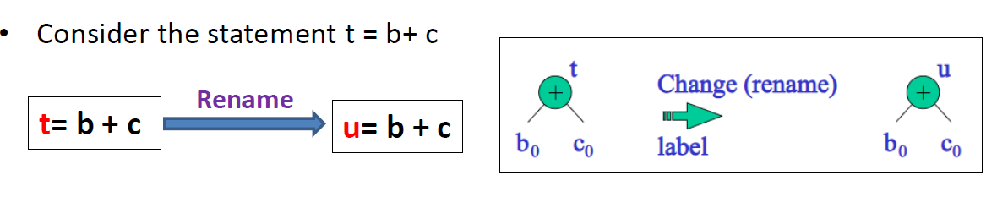
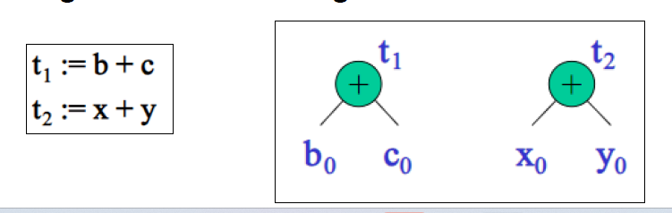
Renaming of temporary variables
Interchange of two independent adjacent statements

Slide 18
Generation of Code from DAGs

Slide 19
Generation of Code from DAGs
Methods generating code from DAGs are:
Rearranging Order
Heuristic ordering
Labeling algorithm

Slide 20




Rearranging Order
The order of three address code affects the cost of the object code being generated.
By changing the order in which computations are done we can obtain the object code with minimum cost.
Example:
t1:=a+b
t2:=c+d
t3:=e-t2
t4:=t1-t3
Three Address Code
$$−$$
t4
$$−$$
t3
t1
$$+$$
e
$$+$$
t2
a
b
c
d

Slide 21
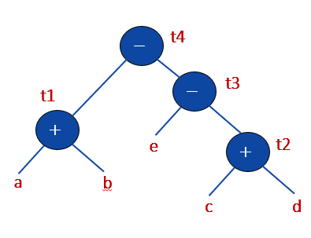
Example: Rearranging Order
t1:=a+b
t2:=c+d
t3:=e-t2
t4:=t1-t3
Three Address Code
t2:=c+d
t3:=e-t2
t1:=a+b
t4:=t1-t3
Three Address Code
Re-arrange
MOV a, R0
ADD b, R0
MOV c, R1
ADD d, R1
MOV R0, t1
MOV e, R0
SUB R1, R0
MOV t1, R1
SUB R0, R1
MOV R1, t4
Assembly Code
MOV c, R0
ADD d, R0
MOV e, R1
SUB R0, R1
MOV a, R0
ADD b, R0
SUB R1, R0
MOV R0, t4
Assembly Code

Slide 22
Algorithm: Heuristic Ordering
Obtain all the interior nodes. Consider these interior nodes as unlisted nodes.
while(unlisted interior nodes remain)
{
pick up an unlisted node n, whose parents have been listed
list n;
while(the leftmost child m of n has no unlisted parent AND is not leaf)
{
List m;
n=m;
}
}

Slide 23


























Example: Heuristic Ordering
$$∗$$
$$1$$
$$Interior nodes=1 2 3 4 5 6 8$$
$$Unlisted nodes=1 2 3 4 5 6 8$$
$$2$$
$$+$$
$$−$$
$$3$$
$$∗$$
Pick up an unlisted node,
whose parents have been listed
$$4$$
$$1$$
$$−$$
$$5$$
$$8$$
$$+$$
Leftchild of 2 =
Parent 5 is not listed so can’t list 6
Leftchild of 1 =
Parent 1 is listed so list 2
$$6$$
$$2$$
$$6$$
$$+$$
$$7$$
$$c$$
$$d$$
$$e$$
11
12
$$9$$
$$a$$
$$b$$
10
Listed Node | 1 | 2

Slide 24

























Example: Heuristic Ordering
$$∗$$
$$1$$
$$Interior nodes=1 2 3 4 5 6 8$$
$$Unlisted nodes=1 2 3 4 5 6 8$$
$$2$$
$$+$$
$$−$$
$$3$$
$$∗$$
Pick up an unlisted node,
whose parents have been listed
$$4$$
$$−$$
$$5$$
$$8$$
$$+$$
Leftchild of 3 =
Parent 2,3 are listed so list 4
Rightchild of 1 =
Parent 1 is listed so list 3
$$3$$
$$4$$
$$6$$
$$+$$
$$7$$
$$c$$
$$d$$
$$e$$
11
12
$$9$$
$$a$$
$$b$$
10
Listed Node | 1 | 2 | 3 | 4

Slide 25











Example: Heuristic Ordering
$$∗$$
$$1$$
$$Interior nodes=1 2 3 4 5 6 8$$
$$Unlisted nodes=1 2 3 4 5 6 8$$
$$2$$
$$+$$
$$−$$
$$3$$
$$∗$$
Pick up an unlisted node,
whose parents have been listed
$$4$$
$$−$$
$$5$$
$$8$$
$$+$$
Leftchild of 5 =
Parent 2,5 are listed so list 6
Leftchild of 4 =
Parent 4 is listed so list 5
$$6$$
$$5$$
$$6$$
$$+$$
$$7$$
$$c$$
$$d$$
$$e$$
11
12
$$9$$
$$a$$
$$b$$
10
Listed Node | 1 | 2 | 3 | 4 | 5 | 6

Slide 26

Example: Heuristic Ordering
$$∗$$
$$1$$
$$Interior nodes=1 2 3 4 5 6 8$$
$$Unlisted nodes=1 2 3 4 5 6 8$$
$$2$$
$$+$$
$$−$$
$$3$$
$$∗$$
Pick up an unlisted node,
whose parents have been listed
$$4$$
$$−$$
$$5$$
$$8$$
$$+$$
Rightchild of 4 =
Parent 4 is listed so list 8
$$8$$
$$6$$
$$+$$
$$7$$
$$c$$
$$d$$
$$e$$
11
12
$$9$$
$$a$$
$$b$$
10
Listed Node | 1 | 2 | 3 | 4 | 5 | 6 | 8

Slide 27
Example: Heuristic Ordering
$$∗$$
$$1$$
Listed Node | 1 | 2 | 3 | 4 | 5 | 6 | 8
$$2$$
$$+$$
$$−$$
$$3$$
Reverse Order for three address code = 8 6 5 4 3 2 1
$$∗$$
$$4$$
t8=d+e
t6=a+b
t5=t6-c
t4=t5*t8
t3=t4-e
t2=t6+t4
t1=t2*t3
OptimalThree
Address
code
$$−$$
$$5$$
$$8$$
$$+$$
$$6$$
$$+$$
$$7$$
$$c$$
$$d$$
$$e$$
11
12
$$9$$
$$a$$
$$b$$
10

Slide 28
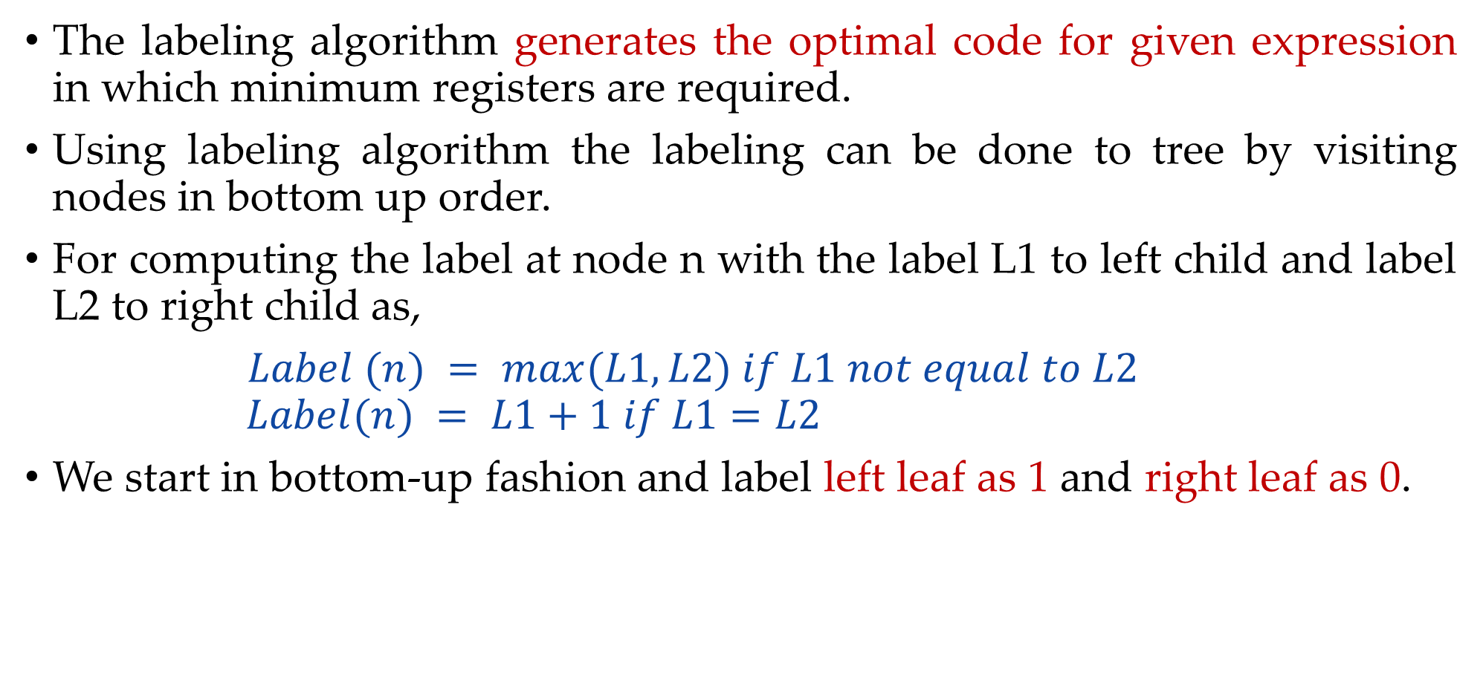
Labeling Algorithm
The labeling algorithm generates the optimal code for given expression in which minimum registers are required.
Using labeling algorithm the labeling can be done to tree by visiting nodes in bottom up order.
For computing the label at node n with the label L1 to left child and label L2 to right child as,
$Label (n) = max⁡(L1,L2) if L1 not equal to L2$
$$Label(n) = L1+1 if L1=L2$$
We start in bottom-up fashion and label left leaf as 1 and right leaf as 0.

Slide 29



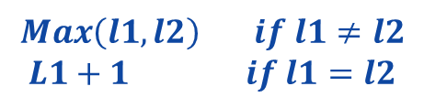




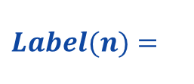







Example: Labeling Algorithm
t1:=a+b
t2:=c+d
t3:=e-t2
t4:=t1-t3
Three Address Code
$$Label(n)=$$
$$Max\left(l1,l2\right) if l1≠l2$$
$$L1+1 if l1=l2$$
$$2$$
$$−$$
t4
$$2$$
t1
$$−$$
t3
$$1$$
$$+$$
$$1$$
$$1$$
e
$$+$$
t2
$$1$$
a
b
$$0$$
$$1$$
c
d
$$0$$
$$postorder traversal=a b t1 e c d t2 t3 t4$$

